Slide 1

Limit Reference Points and the Fish Stocks Provisions
Joint TESA/NOG Workshop
Break-out Group Exercise 3
December 2 2021

Slide 2
Agenda

Slide 3
Exercise 3
Exercise Goal:
Identify ways to define an LRP for Arctic Sardine MU1 in a data-rich context with time varying productivity

Slide 4

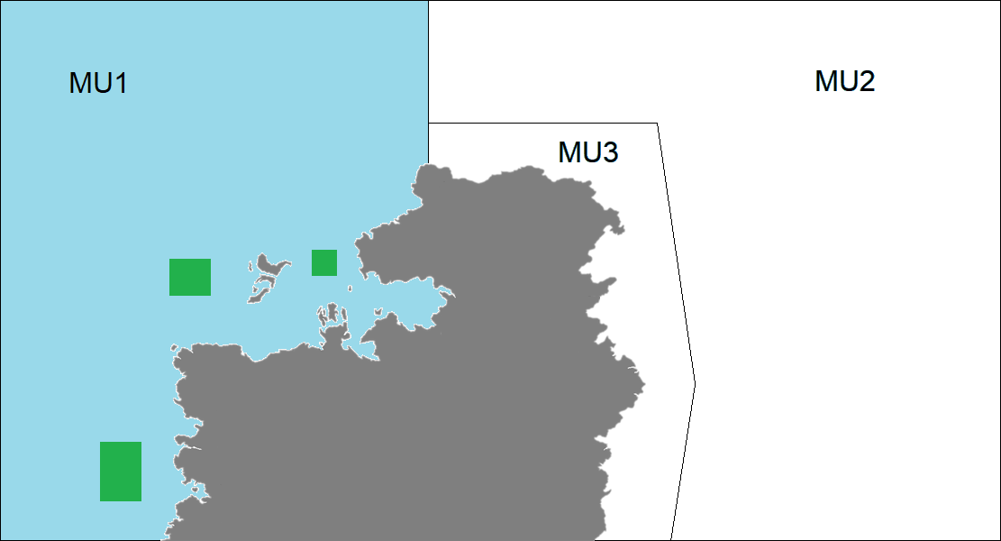
Exercise 3
Age structured model in MU1
B-H SRR with h = 0.75
M = 0.3
Catch and age composition data (50 yrs)
Acoustic surveys (Index of SSB) (25 yrs)
A purse seine fleet and a gill net fleet

Slide 5
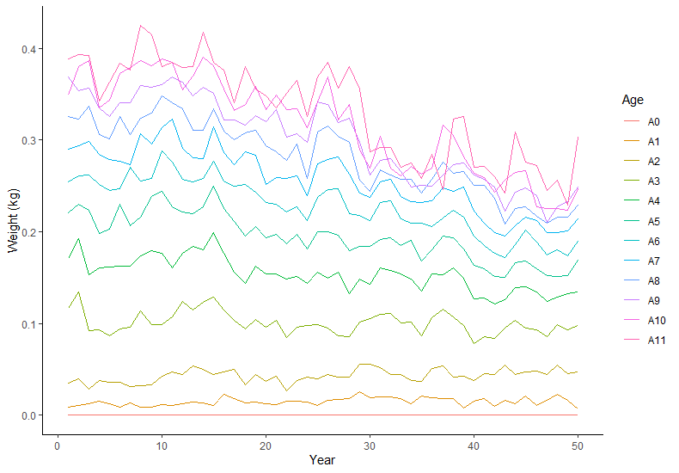
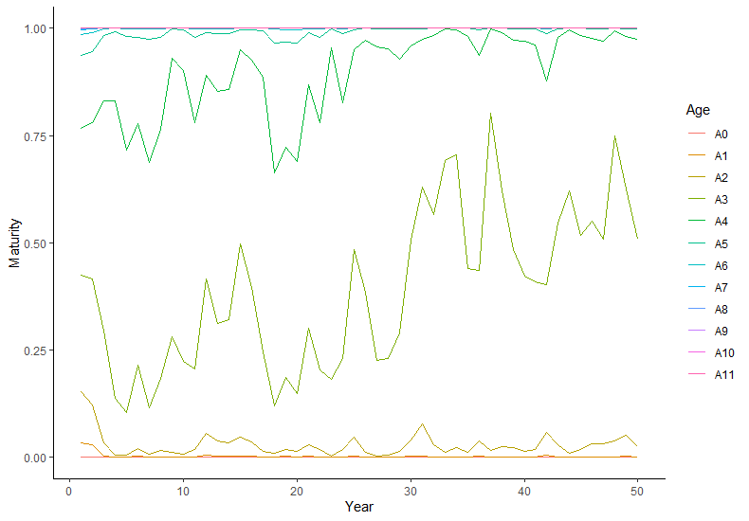
Exercise 3
Weight-at-age and Maturity-at-age

Slide 6
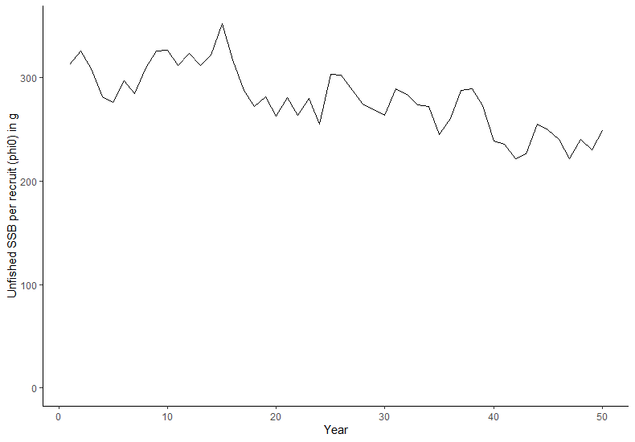
Exercise 3
Unfished SSB per recruit

Slide 7
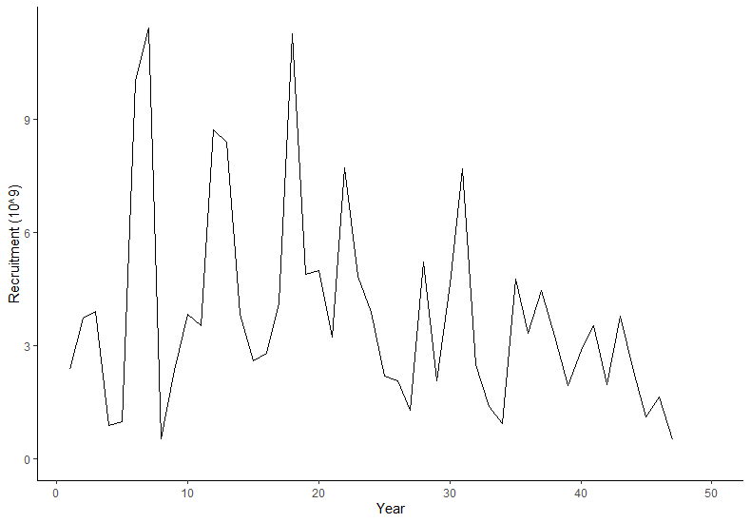
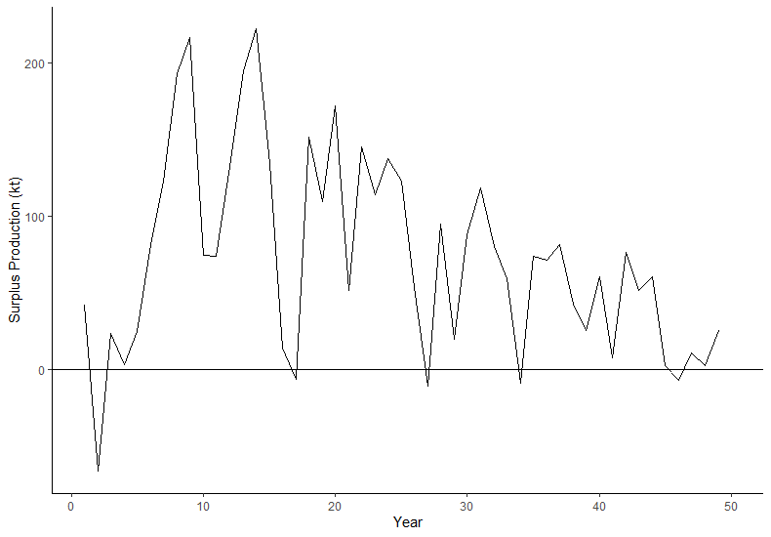
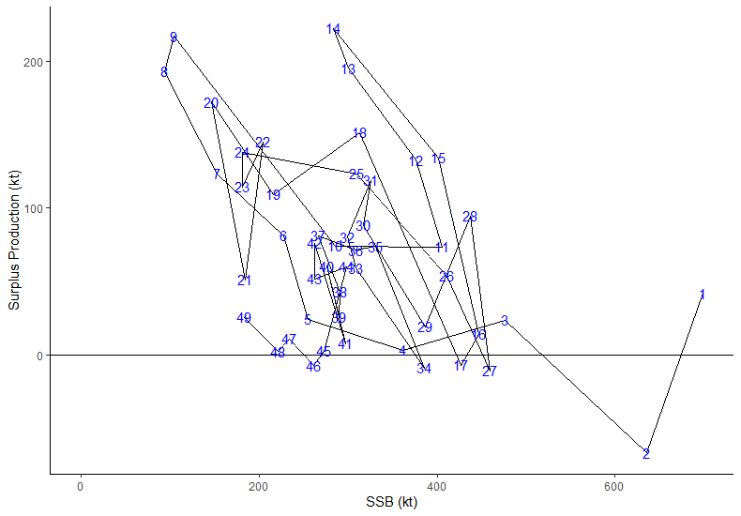
Exercise 3
Surplus Production

Slide 8
Exercise 3
Evaluate at least 2 approaches to defining an LRP for Arctic Sardine in MU1. Identify the “preferred” approach.

Slide 9
Approaches
Static SSB₀ or SSB_{MSY} using equilibrium assumptions
%SSB₀ or %SSB_{MSY} using unfished SSB per recruit over some time period
Dynamic SSB₀ or SSB_{MSY}
%SSB₀ or %SSB_{MSY} (different assumptions on recruitment and weight-at-age)
SSB_{recover}
SSB based on F_{X%SPR}
%SSB_{Fx%SPR}

Slide 10

Exercise 3 Group Presentations

Slide 11
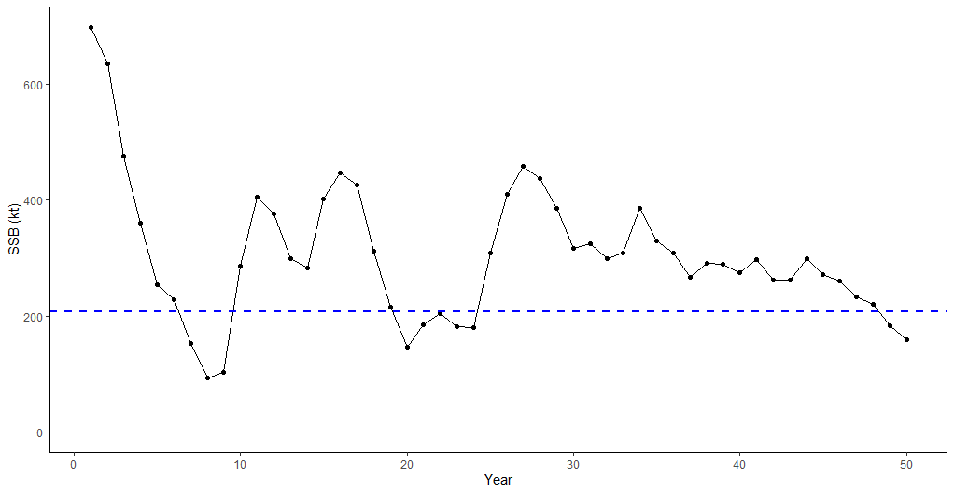
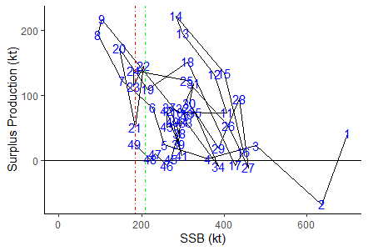
Break Out Group 2
Indicator: SSB
LRP: Brecover *1.X
Rationale: Easy to explain/calculate; stock has recovered – but this may protect against changing conditions, Operationally useful, reliably estimated, best available info, empirically based, possible avoids serious harm,
Stock status year 20: below LRP
Stock status year 50: below LRP

Slide 12
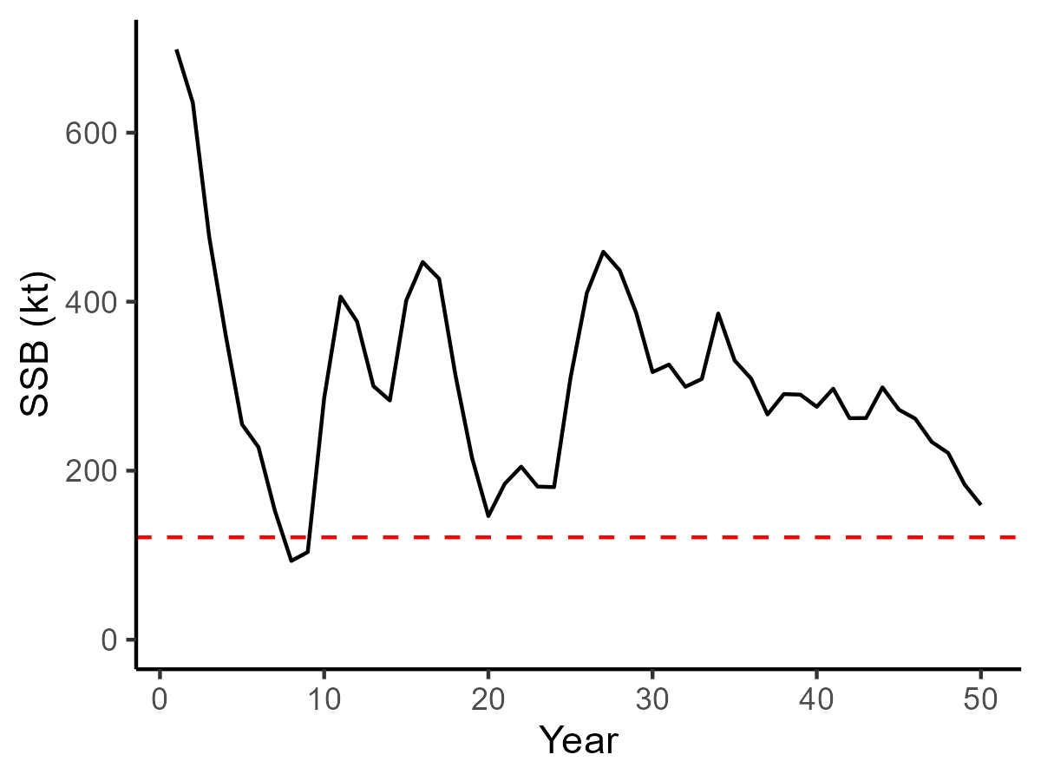
Break Out Group 4
Indicator: SSB
Provisional LRP: 40% of SSB_SPR40% with mean recruitment since year 25 (121 kt)
Stock status in year 20: Above LRP (but not relevant?)
Stock status in year 50: Above LRP
Summary of discussion
Drift in Unfished SSB/R and weight/maturity
Lower recruitment coincides with decrease in older age classes and size of older age classes; may also be reduction in quality of offspring
Whether to consider a breakpoint at year 25 (yes)
Surplus production/SSB – no trend (yrs 26-50)
Quality of assessment may affect how we decide on LRP
Acoustic survey started around year 26 – data differences between two time periods
Catch history – connects the time series between yrs 1- 25, yrs 26-50
Suggest to mgmt a low F policy – should focus more on removal reference as opposed to LRP

Slide 13
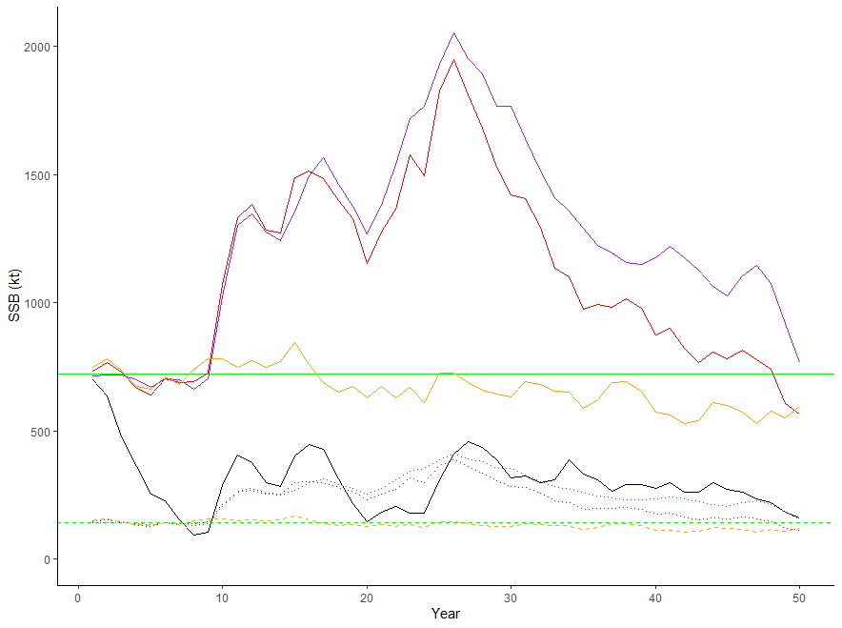
Break Out Group 6
Indicator: SSB
LRP: we considered 3 (Brecover, static 0.2Bo, and dynamic 0.2Bo calculated using on avg_rec)
Rationale: coherence in overlap between Brecover and 2 %Bo options that we considered
Stock status year 20: at or approaching LRP
Stock status year 50: approaching LRP
Dynamic Bo, based on avg_rec

Slide 14
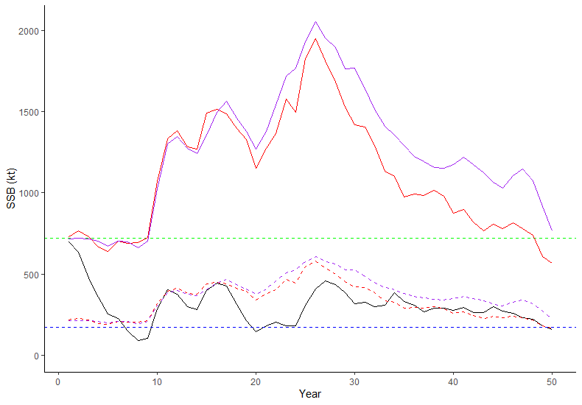
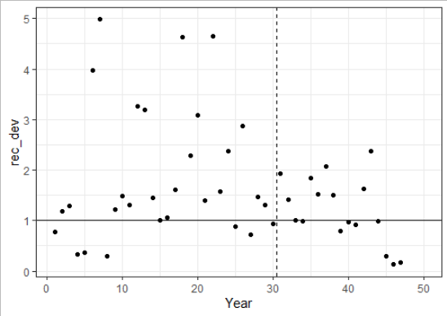
Break Out Group 1
***In real life application, we would not have considered a permanent shift in productivity due to ecosystem changes based on the available data alone, so unlikely to pursue dynamic Ref Points…
**Assuming additional information does indicate an ecosystem shift circa year 30:
Indicator: SSB
LRP: 0.4*SSBmsy, recalculated using:
Average WAA and Mat for years 31-50
SR-based recruitment, without error.
Rationale: Uncomfortable with annual Dynamic SSBmsy; trade-off between accounting for shift and stationarity
Stock status year 20: >LRP
Stock status year 50: >LRP

Slide 15
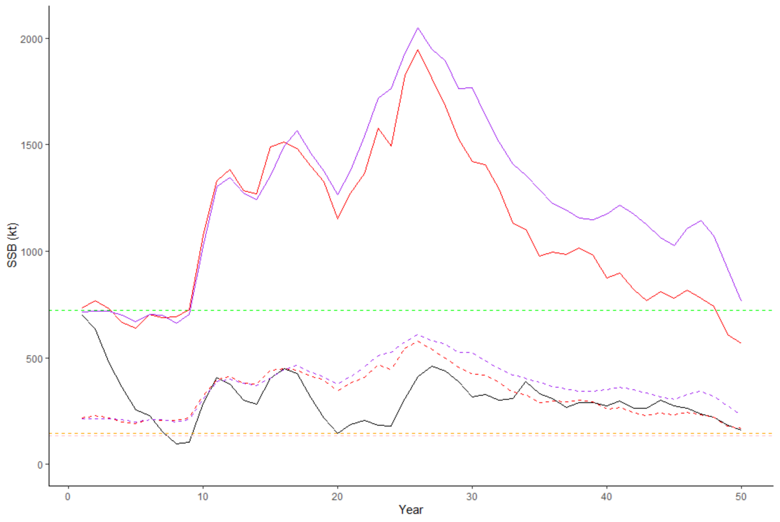
Break Out Group 3
Indicator: population model SSB estimates
LRP: various-
20% of equilibrium unfished SSB0 (using mean phi0 over first 5 years) (yellow dashed horizontal line)
20% of equilibrium unfished SSB0 (using mean phi0 over last 10 years) (pink dashed horizontal line, indistinguishable from yellow dashed line)
40% of equilibrium SSBMSY (using mean phi0 over fist 5 years) (not shown)
40% of equilibrium SSBMSY (using mean phi0 over last 10 years) (not shown)
Rationale: Choice of phi0 averaged over the first 5 years or last 10 years depends on the assumption about if changes in weight at age are due to fishing and are reversible (then use first 5 years) or environmental drivers which may not be reversible (then use last 10 years, i.e., current conditions). Dynamic B0 was not considered as the trends were driven largely by recruitment events
Stock status year 20: ~at LRP
Stock status year 50: just above LRP (note, uncertainty not shown)
Notes:
W

Slide 16
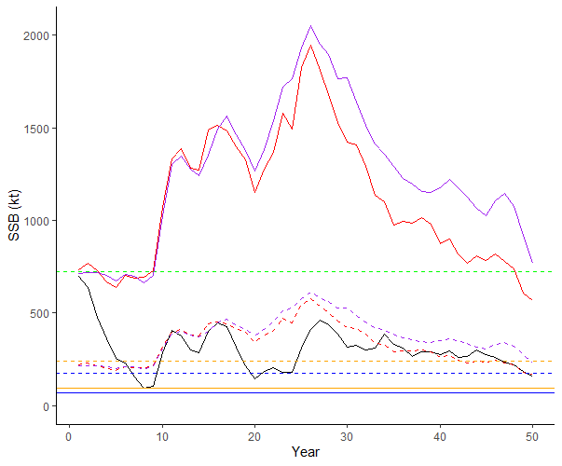
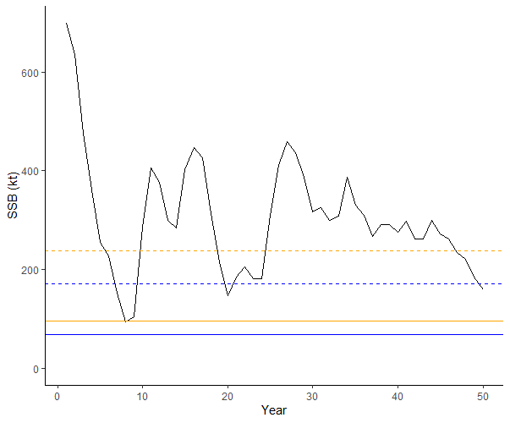
Break Out Group 5
Indicator: Equilibrium SSBmsy
LRP: 68 kt (last 10 years) & 98 kt (first 20 years)
Rationale:
Based on the best available information
Operationally useful
Consistent with an objective to avoid serious harm (maybe on a theoretical view)
Reliably estimated
Stock status year 20: Over LRP
Stock status year 50: Over LRP

Slide 17
Exercise 3 Summary from 6 Groups

Slide 18
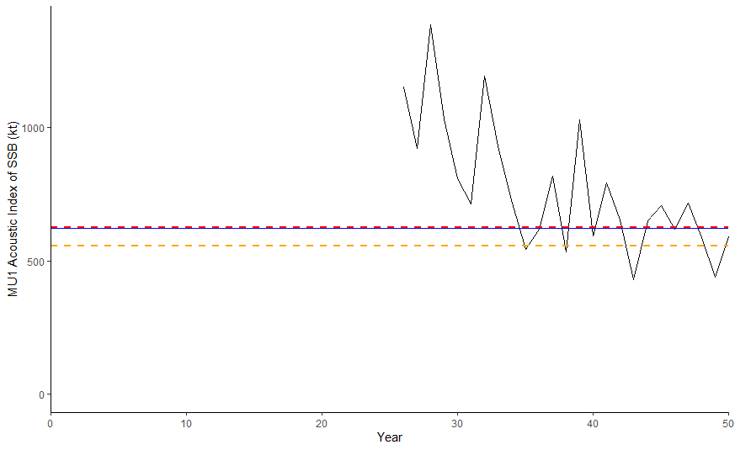
Exercise 1
0.5 B_{MSY} Historical Proxy
0.4 B_{MSY} Historical Proxy
0.4 B_{MSY} (SP model)

Slide 19
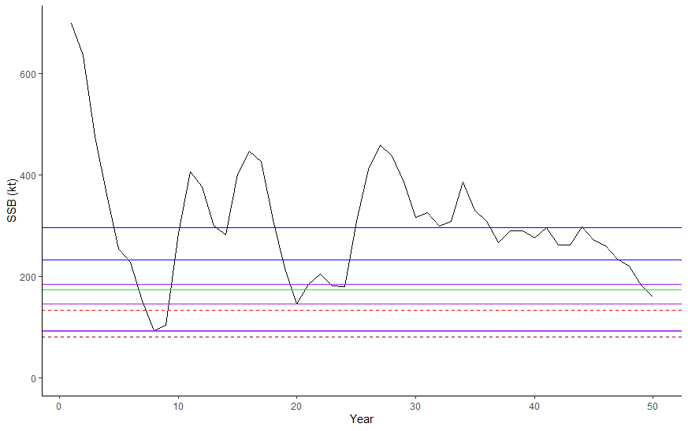

Exercise 2
$${SSB}_{rec}$$
$${SSB}_{F_{SPR40 and 50}}$$
Mean mult approaches
For reference:
0.2${SSB}_{0}$
0.4${SSB}_{MSY}$

Slide 20
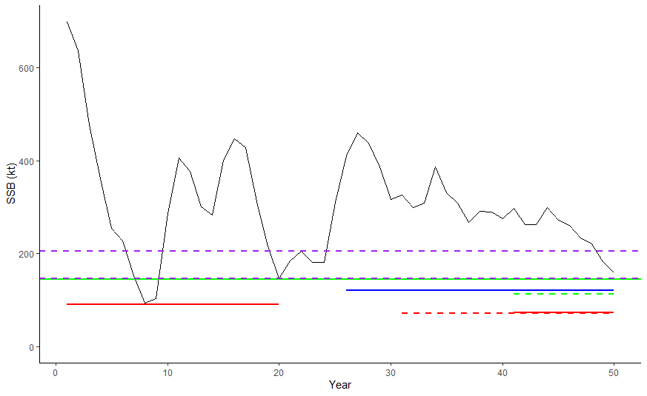

Exercise 3
$${SSB}_{rec}$$
${SSB}_{rec}$/0.2${SSB}_{0}$
0.2${SSB}_{0}$
0.4${SSB}_{F_{SPR40}}$
0.4${SSB}_{MSY}$

Slide 21
LRP Comparisons
Approach | LRP (kt) | Status in Year 50 SSB/LRP | LRP/SSB_{MSY} | LRP/SSB₀
SSB_{rec} | 205 | 0.78 | 1.19 | 0.28
SSB_{rec}/0.2SSB₀ | 146 | 1.1 | 0.85 | 0.20
0.4SSB_{FSPR40} | 121 | 1.3 | 0.71 | 0.17
0.2SSB₀ | 113 | 1.4 | 0.66 | 0.16
Lowest LRP yesterday | 92 | 1.7 | 0.54 | 0.13
0.4SSB_{MSY} | 72 | 2.2 | 0.42 | 0.10
0.4SSB_{MSY} | 69 | 2.3 | 0.40 | 0.10

Slide 22
Discussion points
0.4SSB_{MSY} approach chosen by 2 of the groups
Why the change?
LRP > SSB_{MSY}
Thoughts on the dynamic reference points
Mean approach? Operational implications?
What made you choose 25 vs 20 vs 10 years
Is there a preferred approach? (Live survey in Teams)
Comments from external experts

Slide 23
Candidate Criteria for Best-Practice Indicators and LRPs:
Consistent with an objective to avoid serious harm to the stock
Based on the best available information
Operationally useful
Reliably estimated

